Slide 1
DELAWARE TRUST CONFERENCE
But I Thought It Was Irrevocable?
Using Nonjudicial Settlement Agreements to Modernize Trusts
October 29, 2025
8:00 am – 9:30 am
Michael M. Gordon Gordon, Fournaris & Mammarella, P.A. Wilmington, Delaware mgordon@gfmlaw.com | Elizabeth M. Luk BNY Wealth Wilmington, Delaware eluk@bny.com | Michaelle D. Rafferty Maupin, Cox & LeGoy Reno, Nevada mrafferty@mcllawfirm.com

Slide 2
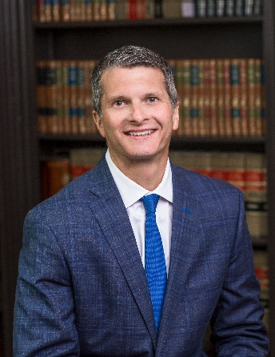
Michael M. Gordon is a Director at the Wilmington law firm of Gordon, Fournaris & Mammarella, P.A. He is a graduate of Fairfield University and the Catholic University of America, Columbus School of Law. He received his Masters of Law in Taxation from Villanova University School of Law in 2008 and is a member of the Delaware and Maryland Bar Associations.
Michael works with clients throughout the country in connection with their trust and estate planning.
Michael’s practice focuses on how clients can achieve estate planning and tax benefits through the use of Delaware trusts. Michael routinely works with clients across the country to transfer the situs of trusts to Delaware and to modify those trusts to take advantage of Delaware’s favorable trust law.
Michael’s practice is unique in that although he does work with clients locally to assist them in the construction of their estate plans he spends the majority of his time working with high net worth clients throughout the country, their advisors, and attorneys to assist them with Delaware-centric trust and estate planning. Michael advises his clients on complex federal wealth transfer techniques that can be accomplished through the use of Delaware trusts. Michael also assists clients throughout the country in connection with income tax planning through the use of Delaware trusts including Qualified Small Business Stock planning and state income tax planning.
Michael is recognized as one of the preeminent estate planning attorneys in the country. He is ranked by Chambers and Partners among the top attorneys in Delaware for Private Wealth Law. He is a fellow of the American College of Trust and Estate Counsel, a national organization of peer-selected lawyers and law professors who are at the top of their profession and committed to maintaining excellence in the field of trust and estate law. Michael routinely speaks at the top estate planning conferences and events throughout the country on trust and estate planning topics.
2

Slide 3
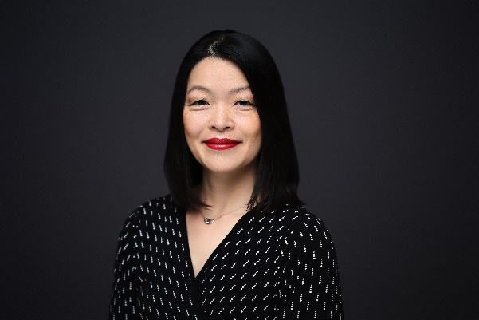
ELIZABETH M. LUK is a Senior Director and Head of Delaware Trust for BNY Wealth. She is a graduate of Emory University, Tulane University School of Public Health & Tropical Medicine and the Elisabeth Haub School of Law at Pace University. She is a member of the New York and Connecticut State Bars, as well as an associate member of the Estates and Trusts Section of the Delaware State Bar Association.
Elizabeth is the Former Chair of the Delaware Bankers Association Trust Conference Planning Committee and served on the Board of Association of Conflict Resolution of Greater NY. She was also an Adjunct Professor at the Elisabeth Haub School of Law at Pace University.
Elizabeth Chairs BNY’s Delaware Trust Administrative Committee and oversees and manages BNY Trust of Delaware fiduciary appointments to address the trust planning needs of her clients in collaboration with trusted advisors. She routinely works with individuals, families and family offices to protect, administer and transfer their wealth. Elizabeth also has a unique focus in working with non-US clients and families with cross-border aspects, including the trust administration of foreign trusts and domesticating or moving foreign trusts into the US.
3

Slide 4
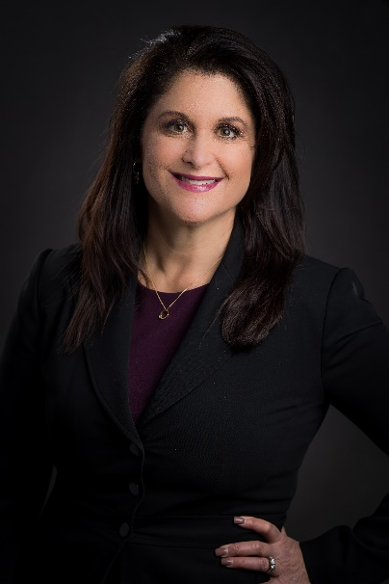
MICHAELLE DiGRAZIA RAFFERTY is a shareholder attorney in the law firm of Maupin, Cox & LeGoy, exclusively practicing in the areas of high net worth estate planning, taxation, administration of trusts and estates, and family trust company planning operations. Michaelle also practices in fiduciary related litigation, audit related matters, and provides expert witness services.
Michaelle has been admitted as a Fellow of the American College of Trust & Estate Counsel (ACTEC) where she serves as a Regent and the Nevada State Chair. Michaelle is a past Chair of the Nevada State Bar Probate & Trust Section where she served as an executive officer for the previous 8 years. She is a current Co-Chair of the Section’s Legislative Committee for Nevada, including drafting and testifying on pending legislation before the Nevada legislature, and appearing before the Nevada Supreme Court on matters of trust and estate litigation.
She serves as the Court-appointed member of the Nevada Supreme Court’s Bench-Bar Committee representing interests of trust and estate counsel. Michaelle is a founding and current Executive Officer for the Probate Bar Association of Washoe County, and has previously served as Executive Officer of the Washoe County Bar Association. She is also a long-standing member of the Northern Nevada Estate Planning Council, and is a frequent speaker and presenter for both national and state continuing education courses related to her areas of practice. Michaelle holds seven “Lawyer of the Year” designations from Best Lawyers, including for 2025 in planning and litigation. She is a Chambers Tier 1 designee for high net worth planning, the past Chair of Cambridge Forum’s Fiduciary Litigation Forum and a planning committee member for Cambridge Forum’s Private Wealth Forum. Michaelle represents diverse clientele including individuals, families, entities, private and commercial trust companies, university foundations, financial institutions, private and public foundations, family offices and private family trust companies. In her free time, Michaelle can be found skiing, hiking, running, biking, or kayaking in the Sierra Nevada mountains and lakes.

Slide 5
INTRODUCTION

Slide 6
Why Do Clients Want to Modernize Trusts and Typical Changes Made to Trusts
A. Beneficial Provisions no Longer Work
Family Changes
Changes in Beneficiary’s Life
B. Outdated Administrative Provisions
Fiduciaries
Other Administrative Updates
C. Outdated Tax Planning
Income Tax
GST & Estate Tax
D. Other Reasons Why Trusts Become Stale
Changes in the Law
Drafting Errors

Slide 7
Strategies to Modernize and Modify Trusts
A. Nonjudicial Settlement Agreements and Nonjudicial Modifications
Overview of Modification
Modification Under the Uniform Trust Code
Judicial Modifications
B. Decanting
Overview of Decanting
Requirements for Use of Decanting Statute
C. Merger
Overview of Merger
Requirements for Use of Merger Statute
D. Division
E. Reformation
Overview of Reformation
Requirements for Reformation

Slide 8
Protecting the Fiduciary in Trust Modifications
A. Statute of Limitations
Time Period
Information Required to Trigger Statute
Virtual Representation
B. Release Agreements
Consent, Release and Indemnity Agreements
Tax Concerns
Judicial Actions
Petition for Instruction
Judicial Accounting

Slide 9
Potential Tax Consequences of Modernizing and Modifying Trusts
A. Overview of IRS Action
B. Income Tax Considerations
Grantor Trust Issues
Identity of the Settlor of the Second Trust
DNI and Transfer Tax Attributed
Recognition of Gain
C. Gift and Estate Tax Considerations
Beneficiary’s Consent to Decanting
Trustee/Beneficiary
Marital Deduction Trusts
Estate Tax
The Delaware Tax Trap

Slide 10
Potential Tax Consequences of Modernizing and Modifying Trusts
D. GST Tax Considerations
GST Exempt Status of a Trust
Decanting as the Exercise of a Limited Power of Appointment
The “Discretionary Distribution” Safe Harbor for Grandfathered Trusts
The “Trust Modification” Safe Harbor for Grandfathered Trusts
Non-Grandfathered Trusts
Effect of Loss of GST Exempt Status

Slide 11
CONCLUSION AND QUESTIONS

Slide 12
Disclosure
This material is provided for illustrative/educational purposes only. This material is not intended to constitute legal, tax, or financial advice. Effort has been made to ensure that the material presented herein is accurate at the time of publication. However, this material is not intended to be a full and exhaustive explanation of the law in any area or of all of the tax or financial options available. The information discussed herein may not be applicable to or appropriate for every person and should be used only after consultation with professionals who have reviewed your specific situation.

